Slide 1
Focus Bracketing, Stacking and Breathing

Slide 2
Introduction
Focus bracketing/stacking is designed to overcome the limits of depth of field. In other words, focus stacking is only necessary if you’re faced with a scene that can’t be well handled by your camera setup’s current depth of field capabilities.
The depth of field is affected by three key factors:
Lens focal length
Distance to the subject
Lens Aperture.
In most situations, you can handle your depth of field requirements without focus stacking. If you’re faced by a sweeping landscape, you can choose a wide-angle lens and you can narrow your aperture; that way, you can capture the entire scene in focus using a deep depth of field. And if you’re faced by a standard close-up subject such as a flower, you can back up slightly from your subject and narrow your aperture to get your desirable depth of field.
But in a few situations, you won’t be able to achieve a deep enough depth of field to keep the entire shot sharp (from the nearest foreground element to the most distant background element).
See later!

Slide 3
Introduction (cont’d)
Specifically, you’ll run into depth-of-field problems when working with:
Very deep landscape scenes
Ultra-close macro subjects
Deep building interiors
Your depth of field just won’t be deep enough, and only parts of the shot will turn out sharp (while other parts will turn blurry).
Of course, you can always try to back up or use a wider lens, but that isn’t always feasible (especially if you’ve already chosen your composition). And you can narrow your aperture, but at a certain point, you’ll start to run into optical problems caused by diffraction.
In such cases, you have two options:
You can take a single shot with a shallower depth of field and try to make the effect work.
Or you can focus stack.

Slide 4
Depth of Field
The depth of field (DOF) is the distance between the nearest and the farthest objects that are in acceptably sharp focus in an image captured with a camera.
DOF Calculator at (for example) Cambridge in Colour: https://www.cambridgeincolour.com/tutorials/dof-calculator.htm
The depth of field can be determined by focal length, distance to subject (object to be imaged), the acceptable circle of confusion size, and aperture. Limitations of depth of field can sometimes be overcome with various techniques and equipment. The approximate depth of field can be given by:
DOF = 2 u² N C / f²
N = aperture F-number C = circle of confusion [an optical spot caused by a cone of light rays from a lens not coming to a perfect focus when imaging a point source **] u = distance to subject f = focal length
(** see John’s presentation material from previous workshop).

Slide 5
Focus Bracketing
Focus bracketing is the general term for a shooting method where you take multiple shots at slightly different focus distances ('bracketing') and then blend or 'stack' them into a single image so that more of a subject or scene is in focus. You can combine your images using editing software (Photoshop or camera-specific software such as Digital Photo Professional for Canon), or (in some cameras) using the in-camera focus stacking tool.
Let’s look at the system used by Canon first:

Slide 6
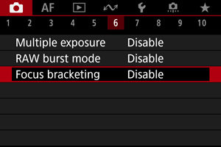
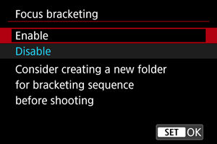
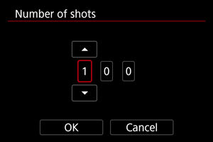
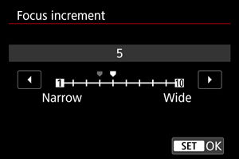
1.
2.
3.
4.

Slide 7
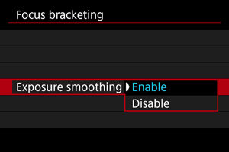
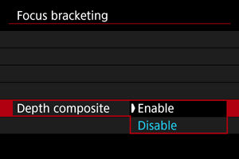
5.
6.
Selecting [Enable] suppresses changes in image brightness during focus bracketing by compensating for differences between the displayed and actual aperture value (effective f-number), which varies by focal position.
Select [Enable] for in-camera depth compositing. Both the depth-composited image [as a JPEG] and the source images are saved.
NOTE that this system is very clever as it gives us one menu item for both bracketing and stacking! ALSO NOTE that Olympus have had in-camera stacking for a very long time and were the first to provide it!

Slide 8
This method (Canon) introduces us to Focus Stacking

Slide 9
Focus Stacking
Focus stacking is a technique designed to achieve a deep depth of field by blending (or stacking) several images together. Each stacked shot is focused on a different spot, so the combined depth of field is deeper than the depth of field produced by any of the individual images.
In both the Canon and Olympus method (and, now, probably others) the in-camera processing gives us a combined (stacked) JPEG image and all others in the bracketing sequence available for combining in computer software such as Photoshop.
NOTE: In the Olympus system there are 2 entirely separate menu items – Focus Bracketing and Focus Stacking as shown in following slide:

Slide 10
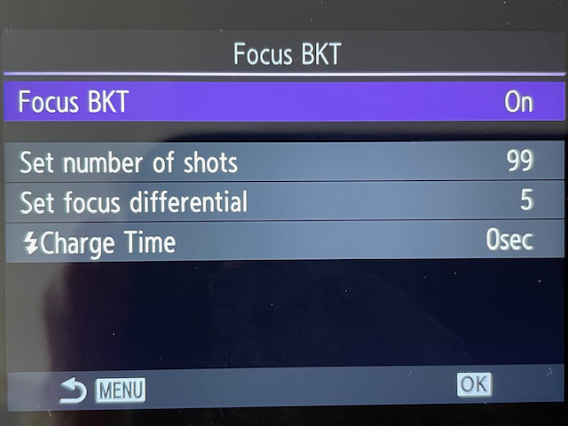
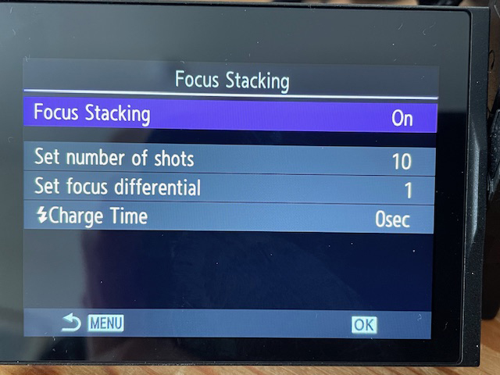
I don’t quite see the point of having both of these as menu items!

Slide 11
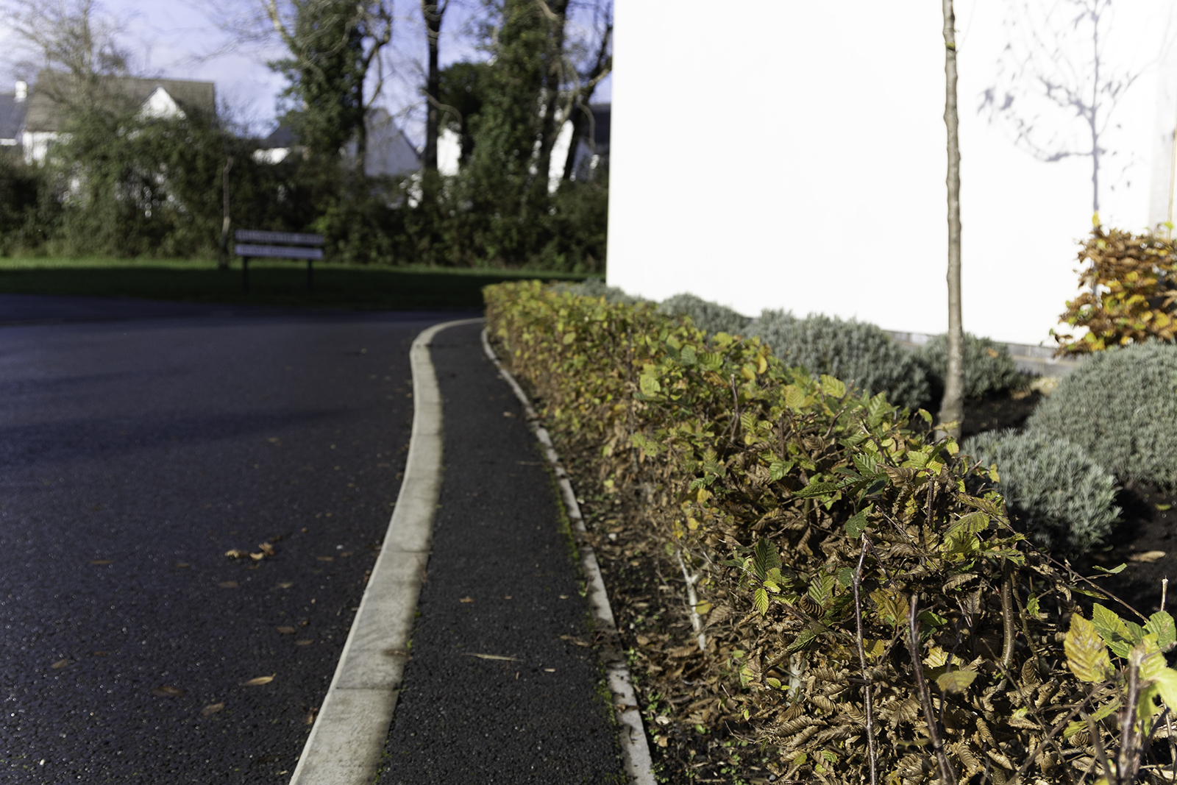
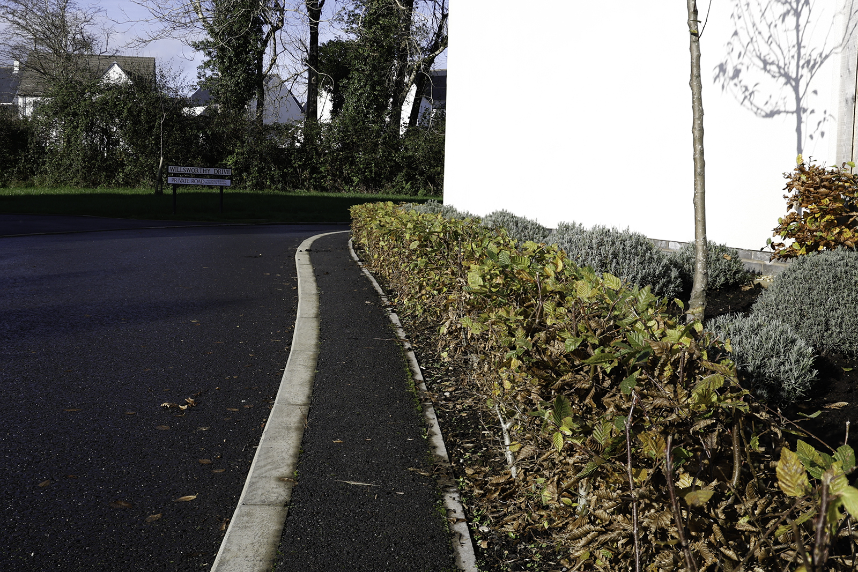
RESULTS
Number 1 in sequence
Mid sequence (of 10)
Focus stacked composite (JPEG)

Slide 12
Focus Breathing
Focus breathing refers to when a lens’s focal length changes subtly (or noticeably) as the focusing distance changes.
Both zoom and prime lenses exhibit this behaviour to varying degrees. One way to see this for yourself is to frame a scene and then change your lens’s focus from minimum to infinity and pay close attention to the edges of the frame — you may notice that the shot seems to “zoom” ever-so-slightly in and out as the focal distance changes.
You can also take two photos keeping everything the same and just have the subject in focus at infinity in one case and at the minimum focusing distance (MFD) in the other. You will notice that there is a slight difference in the focal length (magnification) even though they were shot while keeping the focal length on the lens the same.
Excellent video on DPReview at https://www.dpreview.com/videos/8010417625/dpreview-tv-what-is-focus-breathing-and-why-should-you-care

Slide 13
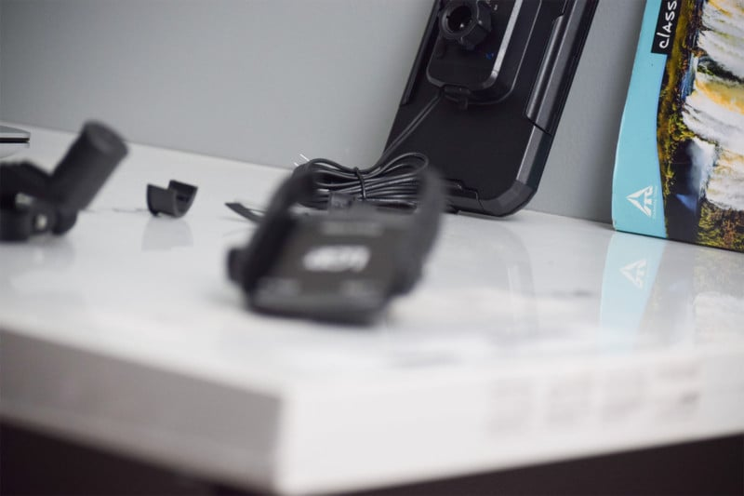
Example of Focus Breathing
In these two example photos, you can see that as the focus is changed from the mobile holder in the foreground to the mirror holder in the background, the second image seems to have been magnified and a little cropped in (they were not cropped in post-production).

Slide 14
So how does one eliminate, or at least reduce, focus breathing artifacts from photos? The simple answer is to upgrade to or buy a lens that does not exhibit focus breathing since it’s a property of the lens and not actually how you use it. But you can still try reducing it by using your existing lens in certain ways. Since the focus breathing is most pronounced in a lens for two photos taken at extreme focal distances (one focusing at infinity and one focusing on the minimum focus distance) you can try reducing this distance and take photos in which the subjects are at almost the same distance from the lens so that you do not have to change (or at least minimize the change in) the focus as much between the shots. Most lenses manufactured for photography, including higher-end ones, do not clearly state if the lens suffers from focus breathing, so it becomes difficult to shop for lenses and do a side-by-side comparison if it is an optical issue that is important to your particular photography work. If the focus breathing magnitude is not mentioned for a lens or a lens combination you wish to compare then you can look at the maximum magnification factor (mostly denoted as 0.15x, 0.25x, 0.38x, 0.71x, etc). The higher the magnification factor the less focus breathing the lens suffers from.
Avoiding the Focus Breathing Issue

Slide 15
Following the lively debate we had at the workshop on Wednesday after the Focus Bracketing/Stacking presentation I’ve had a chance to look at the detailed settings – especially the “increments” setting – as this was the subject of many questions! There is no definitive answer to this by any camera manufacturer so it’s (as we concluded) use trial and error as it depends on the situation you’re trying to capture, the lens, the subject, the first focus point, etc, etc. The best I can offer is this YouTube video based on Canon cameras (but it’s basically the same for most others): https://www.youtube.com/watch?v=xGCpnLGhnsM ENJOY!
Addendum – 22/11/2024

